Slide 1
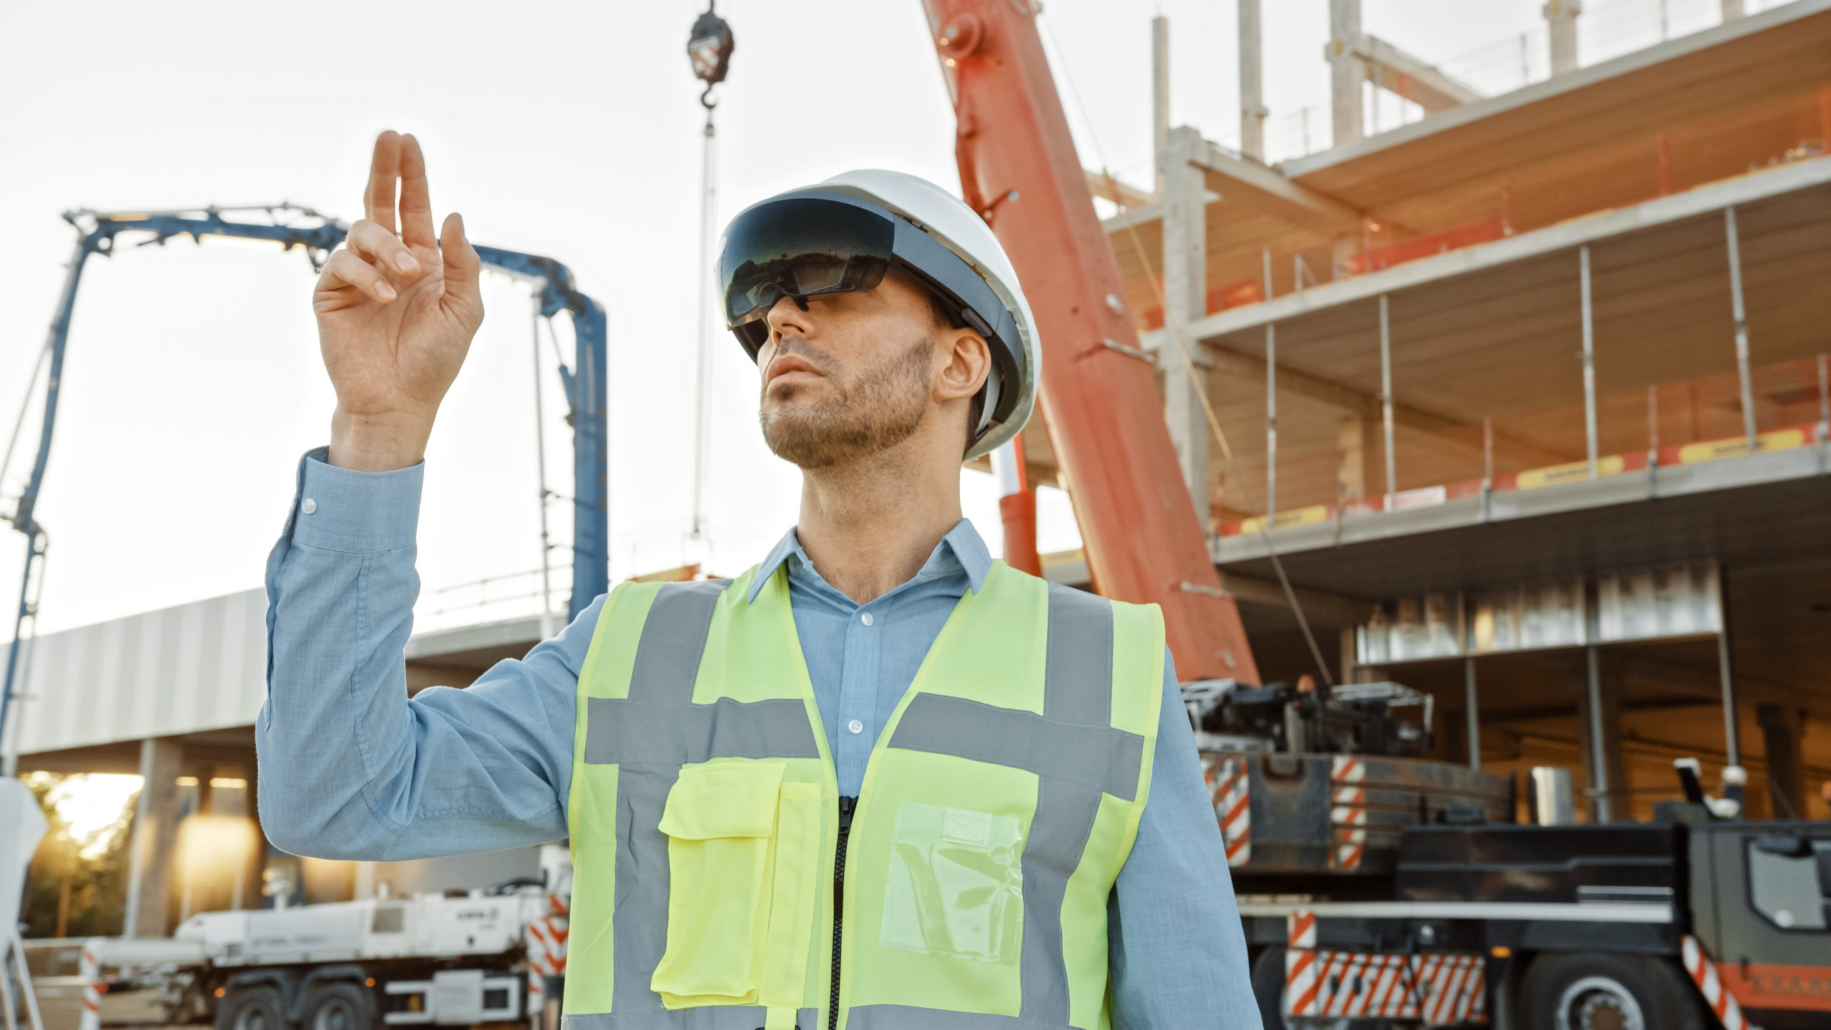
Worker Safety through Predictive AI, AR, IoT, and Federated Worker Safety through Predictive AI, AR, IoT, and Federated Safety System with AR Guidance
AI-Powered Predictive Safety System with AR Guidance
Revolutionizing Worker Safety through Predictive AI, AR, IoT, and Federated Learning
Industrial site with overlayed digital elements like AR markers.
TEAM NAME:DATA DYANAMOS
BY:PASAM NUTAN
SHABBIR AHMED HAASAN
www.reallygreatsite.com

Slide 2
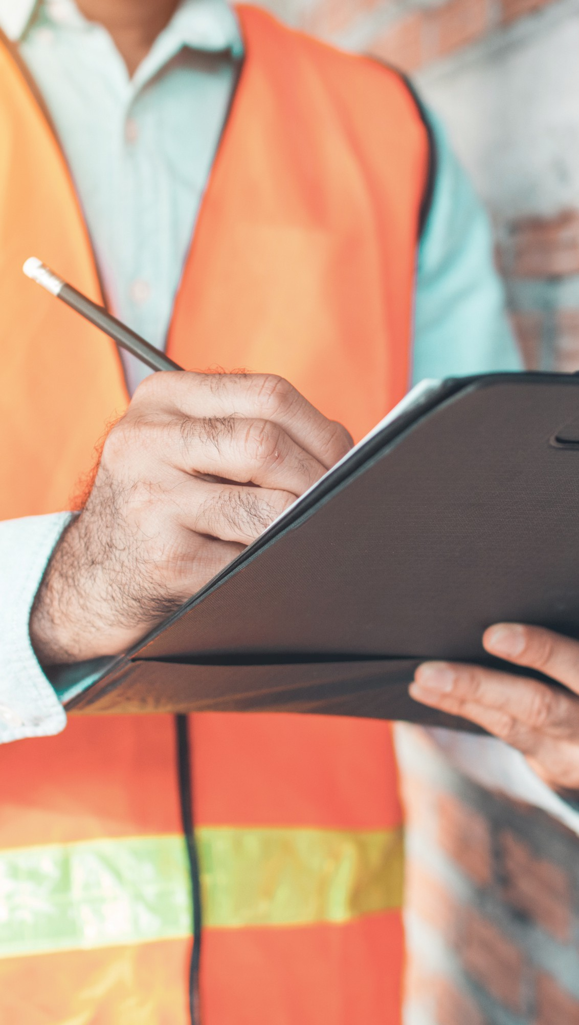
Introduction
AI and AR Transform Workplace Safety
AI analyzes historical and real-time data to predict risks, like equipment malfunctions or unsafe behaviors.
AR provides real-time visual alerts, guiding workers to safety.
Wearable tech monitors vital signs, detecting fatigue or distress, enabling timely interventions.
.
.
AR overlays critical information directly into workers’ field of vision, highlighting hazards and providing step-by-step safety protocols. This immersive approach reduces human error and ensures real-time, adaptive responses to risks through AI-driven data insights.

Slide 3
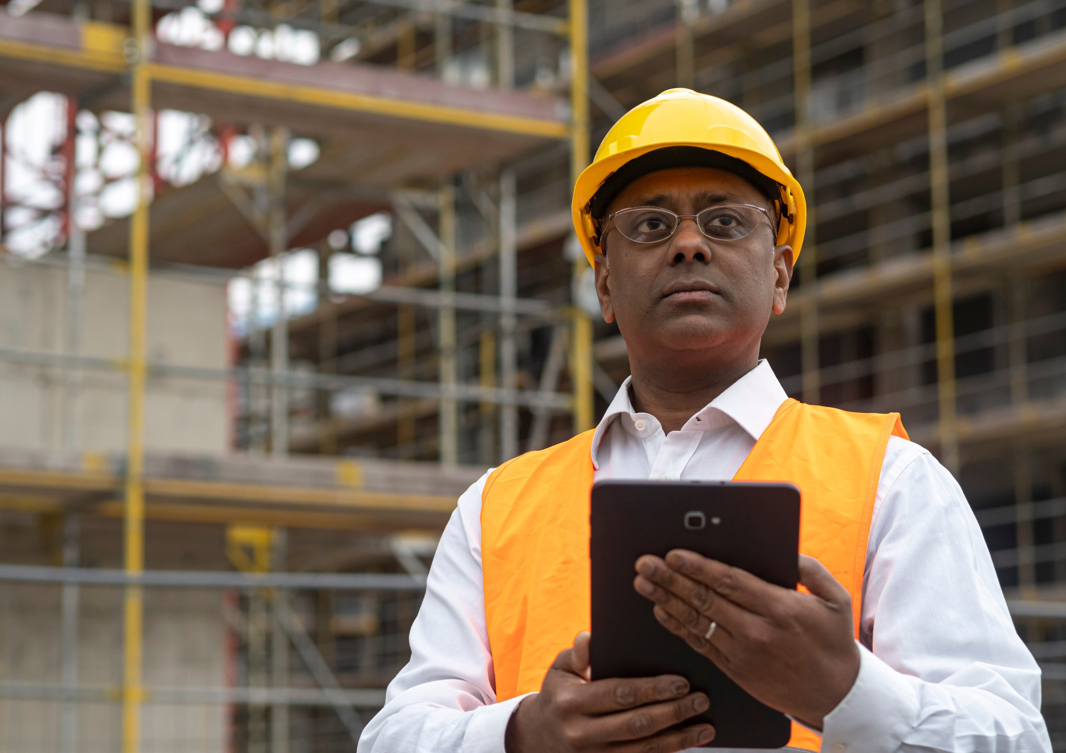
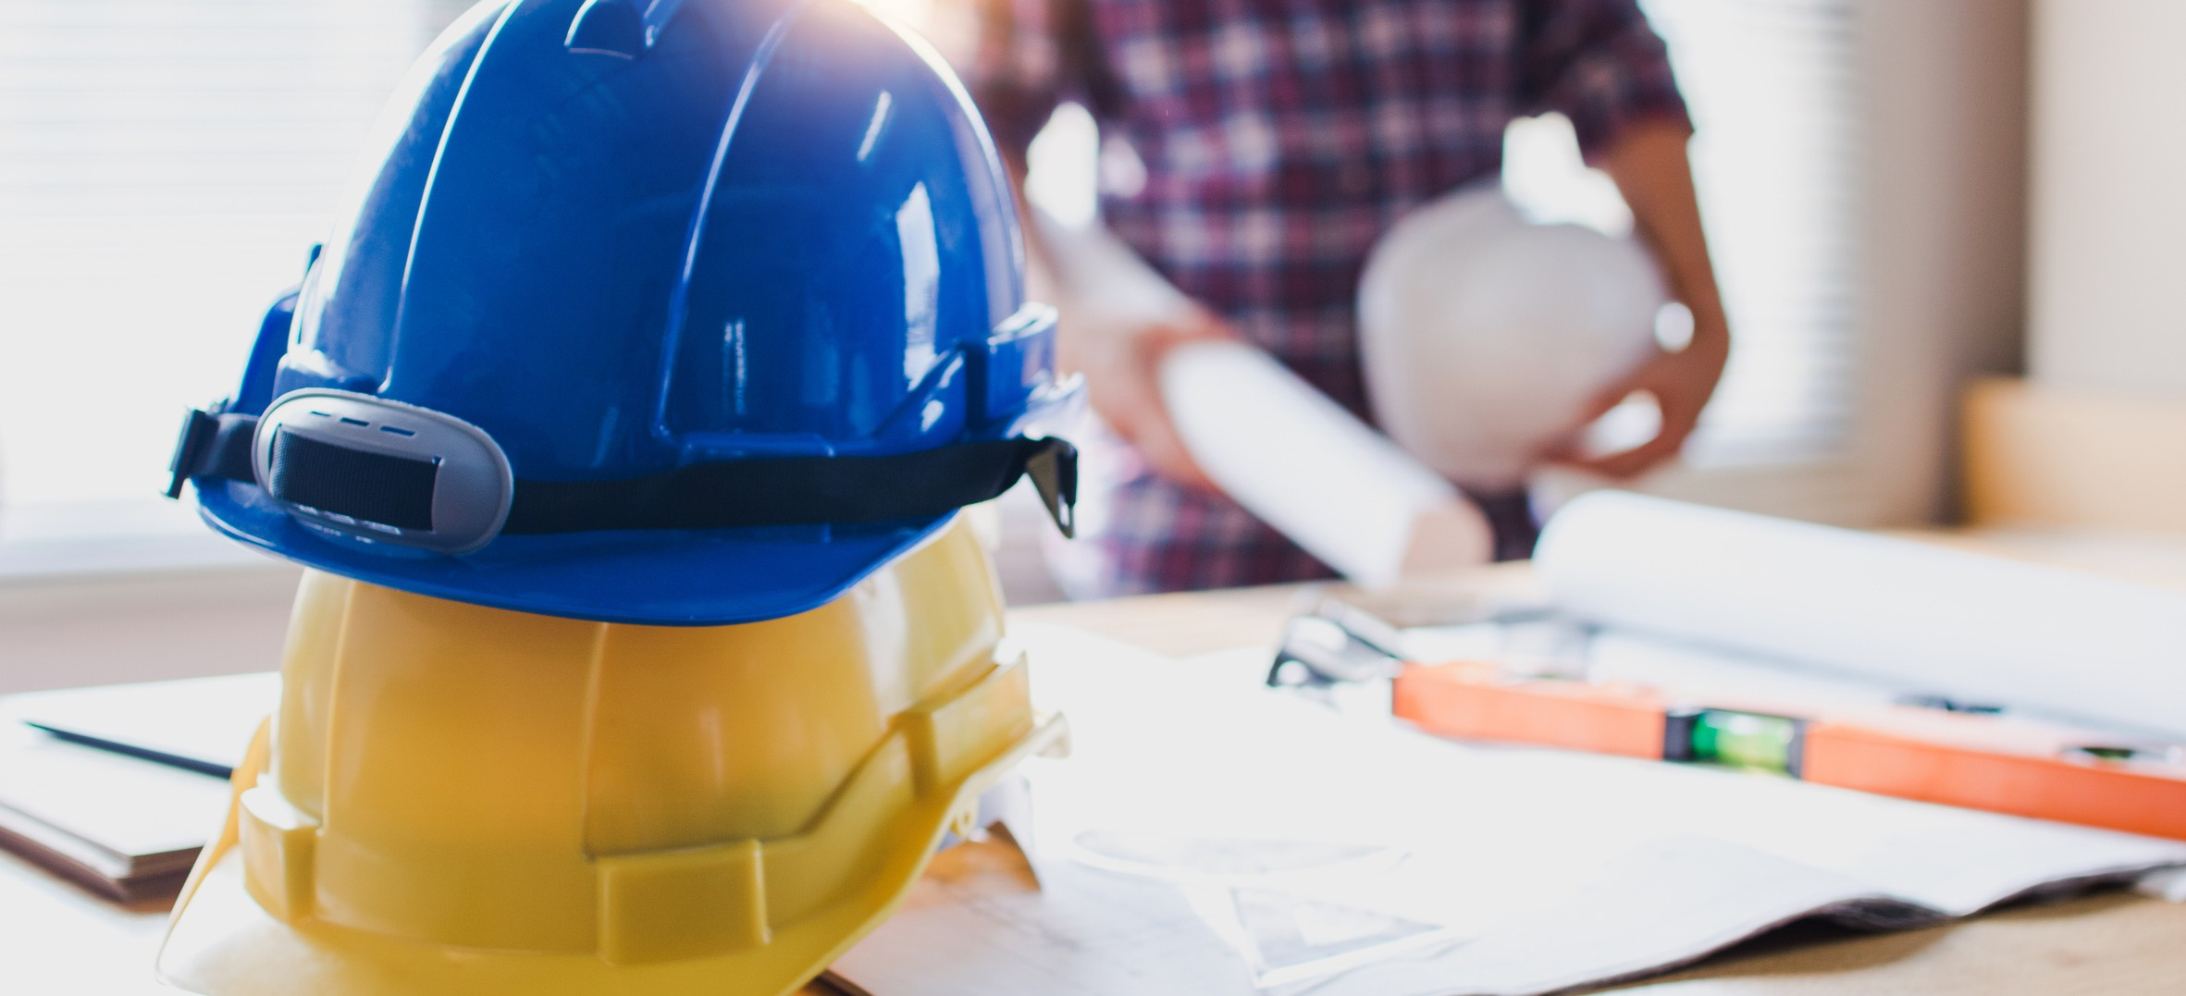
Innovation:
Predictive AI: Analyzes data from IoT sensors and wearables to forecast potential hazards, enabling proactive risk management.
IoT For All
Internet of Things (IoT): Provides real-time monitoring of environmental conditions and equipment status, facilitating immediate hazard detection.
Occupational Health & Safety
Augmented Reality (AR): Overlays critical safety information onto workers' field of vision, offering real-time guidance and enhancing situational awareness.
World Economic Forum
Federated Learning: Enables decentralized training of AI models across multiple devices or locations, ensuring data privacy while continuously improving predictive capabilities.
Impact:
Accident Reduction: Proactive hazard identification and real-time guidance can lead to a significant decrease in workplace accidents.
Cost Savings: Reducing incidents minimizes expenses related to injury claims, equipment downtime, and regulatory fines.
Life Preservation: Enhancing safety protocols directly contributes to saving lives and promoting a healthier work environment.
Feasibility:
Pre-Trained Models: Utilizing existing AI models accelerates development and deployment processes.
Lightweight Tools: Employing efficient development tools ensures rapid prototyping and scalability across various industries.

Slide 4
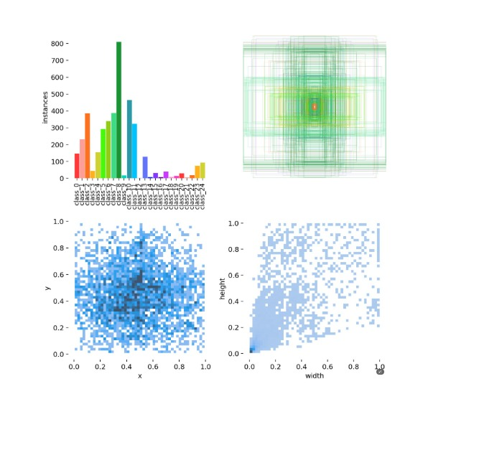
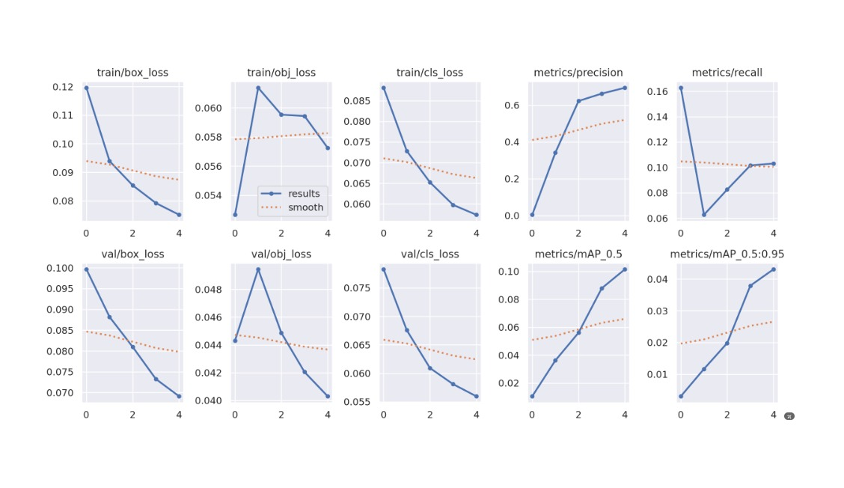
.
.
Implementation Strategy
Planning (Hours 1-3)
Define focus: Hazard prediction, AR alerts, and privacy-preserving AI.
Assign roles for AI, IoT, AR, and backend development.
AI Development (Hours 4-8)
Use YOLOv5 for PPE detection and hazard identification.
Build risk prediction models for fatigue and equipment failure.
IoT & Privacy (Hours 9-12)
Simulate wearable sensors for worker data.
Train models using PySyft for federated learning.
AR Interface (Hours 13-16)
Create AR hazard alerts with Flutter.
Add 3D hazard markers for visualization.
Backend & Dashboard (Hours 17-20)
Use Flask for backend communication.
Build a React.js dashboard for safety metrics.
Integration & Testing (Hours 21-24)
Integrate AI, IoT, AR, and backend components.
Conduct testing and live demo

Slide 5
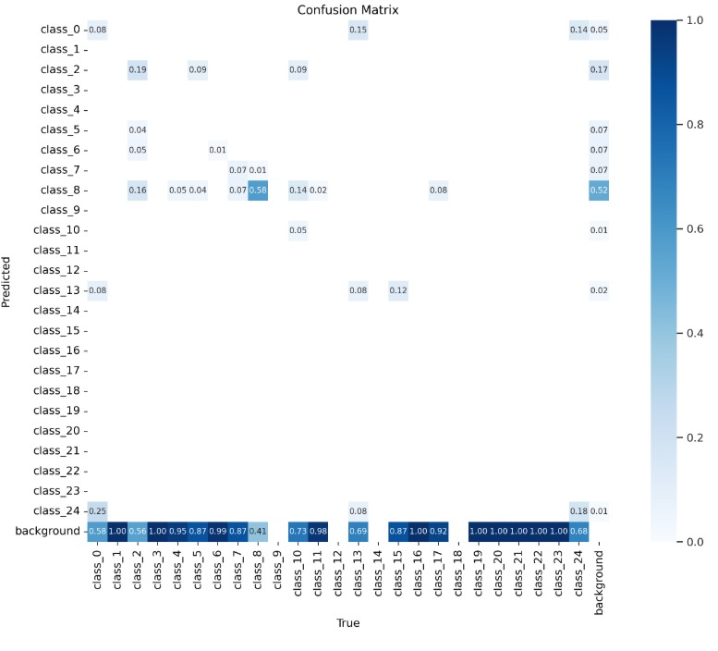
Live Demo: Real-World Impact
Scenario:
Worker Approaches Hazard: A worker nears a live wire.
AI Risk Prediction: The AI system analyzes IoT data to assess risk.
AR Alert: AR glasses display: "High Voltage Ahead!"
Supervisor Notification: The dashboard alerts supervisors.
Deliverables:
Mobile App: Features AR alerts for immediate hazard warnings.
Dashboard: Displays real-time safety metrics and alerts.
Federated Learning Demo: Demonstrates multi-site safety model improvement through federated learning.
.

Slide 6
SOLUTION:
In high-risk industrial sectors like construction, mining, and manufacturing, ensuring worker safety is paramount. An effective solution involves integrating Artificial Intelligence (AI) with Augmented Reality (AR) to create a predictive safety system that not only anticipates potential hazards but also provides real-time guidance to workers. By leveraging AI-powered APIs for visual hazard detection, the system can monitor worksite conditions in real-time, identifying risks such as equipment malfunctions or environmental dangers. When a potential hazard is detected, the AR component delivers immediate visual alerts to workers through smart devices, guiding them to safety. This proactive approach not only prevents accidents before they occur but also fosters a culture of safety and awareness among employees. Implementing such a system can lead to a significant reduction in workplace incidents, ensuring a safer environment for all.

Slide 7

Scalability & Future Scope
Expanding Horizons
Content:
Advanced Technology Integration:
Smart Helmets and Drones: Enhance hazard detection by incorporating sensor-equipped smart helmets and deploying drones for aerial monitoring, providing comprehensive safety coverage.
Blockchain for Incident Reporting: Implement blockchain to create immutable and transparent audit trails for incident reporting, ensuring data integrity. Edge AI Deployment:
On-Site Processing: Deploy AI models on edge devices to enable real-time, on-site data processing, reducing latency and improving hazard detection responsiveness.
Industry Adaptation:
Sector Customization: Tailor the system for various industries such as construction, mining, and manufacturing, addressing unique safety challenges in each field.
Enhanced Predictive Analytics:
Proactive Risk Mitigation: Utilize AI to predict potential hazards before they occur, allowing for preventive measures and reducing workplace accidents.

Slide 8
Conclusion
Integrating advanced technologies like AI, AR, smart helmets, drones, blockchain, and edge computing into workplace safety systems offers a comprehensive approach to hazard detection and prevention.
These innovations enable real-time monitoring, predictive analytics, and proactive risk mitigation, leading to safer work environments across various industries.
By embracing these scalable solutions, organizations can significantly reduce workplace accidents and enhance overall safety protocols.

Slide 9



y
Thank You!
-TEAM DATA DYANAMOS
Contact Information:
GITHUB LINK:
https://colab.research.google.com/drive/1QZd3o_4E6ijivuxlQRu19JRxrCy_1GE9#scrollTo=gaHXs6ltintQ

